Slide 1
ReactJS
about new

Slide 2
It’s aright to:
Ask questions
Ask about new words or terms
Clarify confusing concepts
Relax and have fun
Notes:
Before we start, I highly encourage you to ask questions.
If you have questions or clarifications that you want to ask me, please do not hesitate to raise your hands.
I highly encourage you to ask questions. ReactJS can be very confusing or hard,
even for those who have experience programming.
Third, you are most welcome to clarify things before we proceed with the next topic.
Finally, please relax. Just chill and have fun. Programming can sometimes be difficult but it is what it make it fun too.
This course takes into account that you have no prior knowledge with programming.

Slide 3
First things first …
We already know the basics of Javascript and HTML
We will cover the basics of ReactJS only
We will be building a single page application
Notes:
Assumed that we know the basics of HTML and javascript. We are also familiar with object oriented programming concepts.
Cover the basics only. We will not tackle advanced concepts in React. If we already know React, we had designed this curriculum with newbies in React in mind. We will provide the initial push towards learning, it is up to us to further our knowledge or skill.
We will discuss the overview of how react works but not in detail. We will focus more on how to use React to build a single page application
What we are building is a single page application. We will not tackle server side rendering or lazy loading. We will discuss what is a single page application later.

Slide 4
First things first …
We should know how to use git
Disclaimer: I am not an expert in React.
Google is your friend
Do not give up
Notes:
We should also know how to use git. Activities are checked via github. I'll discuss this later.
Please ask questions. If a concept is confusing, please let me know.
Disclaimer: I am not an expert in React. You might have a question that I can't answer right away, I'll take note of it and answer you after the session.
Google is your friend. React is a new framework. It changes every month. What you may know now is different next few months after.
Lastly, do not give up. Learning ReactJS is hard. It will introduce new programming paradigms that will be completely new to you. So don't give up. Relax and have fun especially when you hit a wall.

Slide 5
Environment Setup

Slide 6
IDE / Text Editor
Use any text editors or IDEs (use what you prefer)
Examples:
VS Code
Atom
Sublime Text
IntelliJ / Webstorm

Slide 7
Git and Github Account
All activities are sent via github
Discuss at the end of the session how to pass activities
Use any git client you want eg. SourceTree, Git Kraken, Tortoise Git

Slide 8
Node Package Manager (npm)
npm is the standard package manager for Node.js.
Used for dependency management
Allows installation of thousands packages / modules
Equivalent to Gradle, Maven, pip, etc
Notes:
The main goal, as you touched upon, is automated dependency and package management. This means that you can specify all of your project's dependencies inside your package.json file, then any time you (or anyone else) needs to get started with your project they can just run npm install and immediately have all of the dependencies installed. On top of this, it is also possible to specify what versions your project depends upon to prevent updates from breaking your project.

Slide 9
Node Package Manager (npm)
Installs the dependencies by running the command npm install
Looks for package.json in the project directory

Slide 10
Node Package Manager (npm)
What is a package?
A package contains all the files you need for a module.
Modules are JavaScript libraries you can include in your project.

Slide 11
Node Package Manager (npm)
How do you download a package?
You can download it manually but it is tiresome
Use npm and install it in app
Example:
You want to install react-mic
npm install react-mic
Add --save to automatically save to package.json
Notes:
Show demo

Slide 12
Node Package Manager (npm)
How do you use the package?
Old way:
const rm = require('react-mic);
ES6 way:
import { ReactMic } from 'react-mic’;

Slide 13
Tip:
To make development easier, search for libraries that will help you in development.
Notes:
Think of DRY and WET principles

Slide 14
Good Tools for ReactJS Development
If you’re learning React or creating a new single-page app, use Create React App.
If you’re building a server-rendered website with Node.js, try Next.js.
If you’re building a static content-oriented website, try Gatsby.
Notes:
We will not be discussing the other tools. We will be focusing on Create React App since we are building a Single Page App.

Slide 15
create-react-app
Github Repository https://github.com/facebook/create-react-app
A node module that allows us to build single page ReactJS application quickly
It is also ideal for learning ReactJS
Maintained by Facebook
Notes:
Create React App is a comfortable environment for learning React, and is the best way to start building a new single-page application in React.
Typically, you need to use a bundler like webpack to start using ReactJS. It creates an abstraction wherein you get to make ReactJS apps right away.
Also endorsed/suggested by Facebook.

Slide 16
create-react-app
How do I install create-react-app?
npm install -g create-react-app
-g stands for global (it will be installed in your PC and not your project)

Slide 17
create-react-app
How do I create and start a project in create-react-app?
Run the following lines:
npx create-react-app <name of your app>
cd <name of your app>
npm start

Slide 18
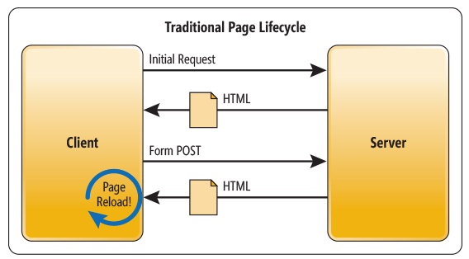
Traditional Web Application

Slide 19
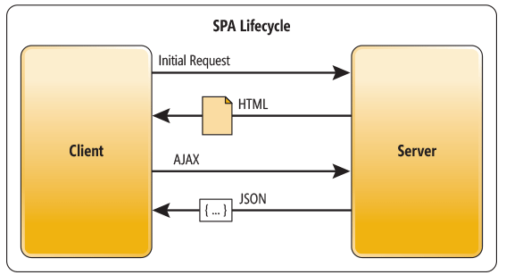
Single Page Application

Slide 20
Summary
NPM is used for installing libraries/modules for project
create-react-app is used for starting react projects that are single page applications right away

Slide 21
Tools Used in this Training
Text editor of your choice
npm for installing create-react-app and other modules
git

Slide 22
Activity 1
Before starting do this first:
Login to your GitHub account
Fork the repository below https://github.com/bryancabansay/react-training using github
Clone your fork to your PC
Read and follow the instructions found in activities/instructions.txt

Slide 23
Activity 1
Create a new branch from master named activity/<folder name based on instructions.txt>
Example: activity/jappleseed
Checkout to your new branch
Work on the activity
Save your work in your folder

Slide 24
Activity 1
Commit your changes (Commit message should contain the words “Activity <number of the activity>”
Example: Activity 1 – First commit
Push changes to your fork
Create a pull request

Slide 25
Activity 1
Requirement:
Create a ReactJS application using create-react-app and save to your folder.
It should say:
“Hello World, I am <YourName>!”

Slide 26
Javascript Basics ECMAScript 6 (ES6)

Slide 27
ECMAScript 6
Also known as ES6 and ECMAScript 2015.
New syntax for Javascript
Nice training site for Javascript: https://javascript.info/
Babel is used to convert ES6 to old Javascript
Notes:
Before we start learning ReactJS we will need to familiarize ourselves with basic javascript because it might get confusing if we are not able to follow the syntax
Please note that we will be using a new form of Javascript which is EcmaScript 6 (ES6). Typically, current browsers are not able to read ES6. We are using Babel, a javascript compiler/transpiler to convert our code to old javascript.

Slide 28
JSON – Javascript Object Notation
Data is in name or key/value pairs
Data is separated by commas
Curly braces hold objects
Square brackets hold arrays
Notes:
JSON is short for JavaScript Object Notation, and is a way to store information in an organized, easy-to-access manner. In a nutshell, it gives us a human-readable collection of data that we can access in a really logical manner.
This also represents an object in Javascript

Slide 29
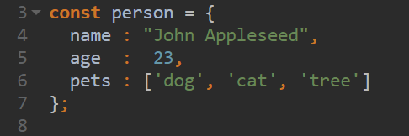
JSON – Javascript Object Notation
Notes:
Data is in name or key/value pairs
Data is separated by commas
Curly braces hold objects
Square brackets hold arrays

Slide 30
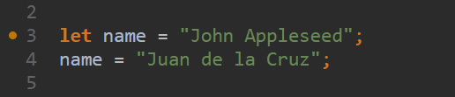
Variable declaration
let allows you to declare variables that are limited in scope to the block, statement, or expression on which it is used.
Use this instead of var
Notes:
let allows you to declare variables that are limited in scope to the block, statement, or expression on which it is used. From now on, practice using let instead of var.

Slide 31
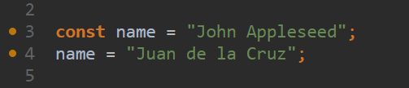
Variable declaration
const is used for declaring constants.
Means you are not able to reassign the variable to another value. But you can mutate the value.
* This will cause an error
Notes:
const is used for declaring constants. This means you are not able to reassign the variable to another value. But you can mutate the value. The code will cause an error since you are reassigning the variable name to another value

Slide 32
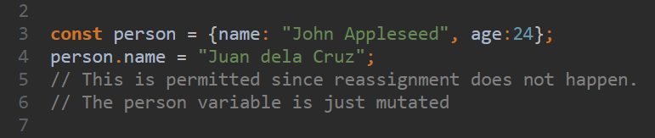
Variable declaration
Notes:
const is used for declaring constants. This means you are not able to reassign the variable to another value. But you can mutate the value. The code will cause an error since you are reassigning the variable name to another value

Slide 33
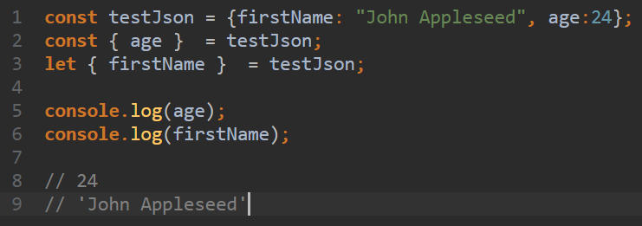
Variable declaration

Slide 34
Arrow Functions
Concise syntax for writing function expressions
Utilizes the => token
Notes:
Also called fat arrows more concise syntax for writing function expressions. They utilize a new token, =>, that looks like a fat arrow. Arrow functions are anonymous and change the way this binds in functions.

Slide 35
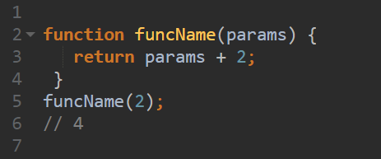
Normal Function
Notes:
Also called fat arrows more concise syntax for writing function expressions. They utilize a new token, =>, that looks like a fat arrow. Arrow functions are anonymous and change the way this binds in functions.

Slide 36
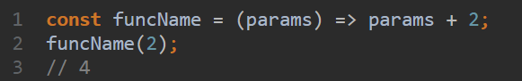
Arrow Function

Slide 37
Arrow Function Patterns
(parameters) => { statement/s }
() => { statement/s }
parameter => { statement/s }

Slide 38
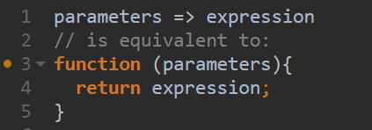
Arrow Function Patterns

Slide 39
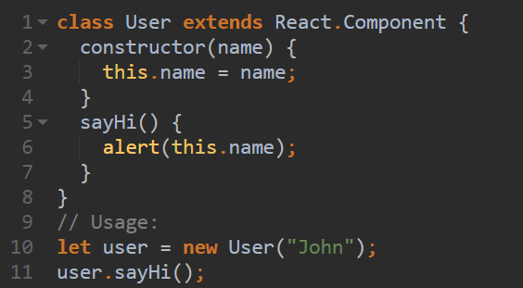
Class Declaration

Slide 40
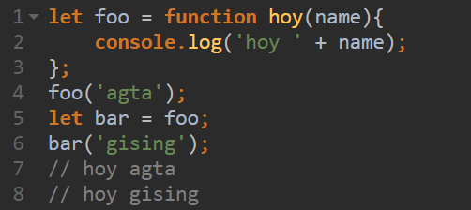
Pass Functions as Variables

Slide 41
Summary
We will be using ES6 syntax.
JSON is used for describing objects in Javascript
Use let for variables that are not reassigned. Use const for non changing ones.

Slide 42
Summary
You can use arrow functions [ => ]
Javascript allows creation of classes and other OOP principles
You can pass functions as variables in JS

Slide 43
Useful Videos
https://www.youtube.com/watch?v=ZNbFagCBlwo
https://www.youtube.com/watch?v=xfGciVdbktI
https://www.youtube.com/watch?v=Jakoi0G8lBg

Slide 44
Useful Videos
https://www.youtube.com/watch?v=ycstRj2i66k
https://www.youtube.com/watch?v=BYbgopx44vo

Slide 45
What is ReactJS?

Slide 46
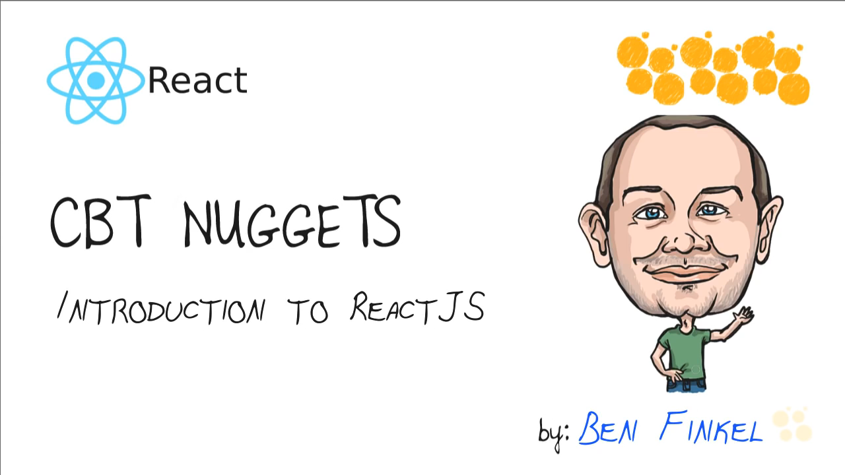
What is ReactJS

Slide 47
What is ReactJS
React is a front-end library developed by Facebook.
It is used for handling the view layer for web and mobile apps.
ReactJS allows us to create reusable UI components.

Slide 48
What is ReactJS
It reacts to changes in the state of the app
Think of the state as the current truth about your application.
Leverages virtual DOM technology (that is why it is fast)

Slide 49
What is Virtual DOM?
DOM stands for “Document Object Model”
Whole html document is a DOM.
Every time there is a change in the state of your application UI, the DOM gets updated to represent that change. Now the catch is frequently manipulating the DOM affects performance, making it slow.

Slide 50
What is Virtual DOM?
The virtual DOM is only a virtual representation of the DOM. In ReactJS it is a very big JSON object.
Every time the state of our application changes, a new virtual DOM is created and is compared with the previous one.
Notes:
The virtual DOM is only a virtual representation of the DOM. In ReactJS it is a very big JSON object.
Everytime the state of our application changes, a new virtual DOM is created and is compared with the previous one.

Slide 51
What is Virtual DOM?
Then the difference calculated so that only parts of the actual DOM affected are updated.
If this process is done using the actual DOM, it would be very slow.
Notes:
Then the difference calculated so that only parts of the actual DOM affected are updated.
If this process is done using the actual DOM, it would be very slow.

Slide 52
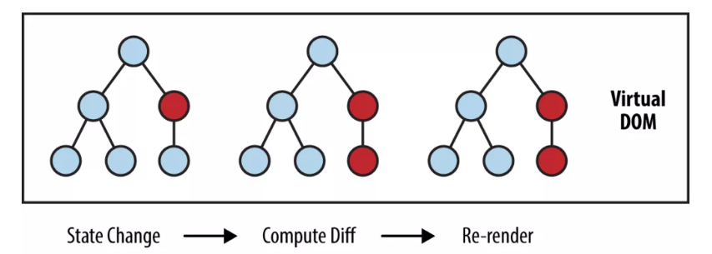
What is Virtual DOM?

Slide 53
Rendering Elements
An element describes what you want to see on the screen:
const element = <h1>Hello, world</h1>;
Unlike browser DOM elements, React elements are plain objects, and are cheap to create. React DOM takes care of updating the DOM to match the React elements.

Slide 54
Rendering an Element into the DOM
Let’s say there is a <div> somewhere in your HTML file:
<div id="root"></div>
We call this a “root” DOM node because everything inside it will be managed by React DOM.
Notes:
Applications built with just React usually have a single root DOM node.
(See create-react-app output)

Slide 55
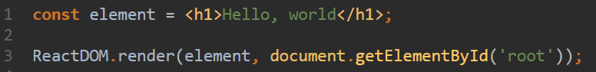
Rendering an Element into the DOM
To render a React element into a root DOM node, pass both to ReactDOM.render():
Notes:
Applications built with just React usually have a single root DOM node.
(See create-react-app output)

Slide 56
Components

Slide 57
Components
Components are the building blocks of all React applications.
Think of components as bite-size chunks of our application that we can reuse all over our site.

Slide 58
Components
It is a JavaScript class or function that optionally accepts inputs i.e. properties(props) and returns a React element that describes how a section of the UI (User Interface) should appear.
2 Types (Smart & Dumb)

Slide 59
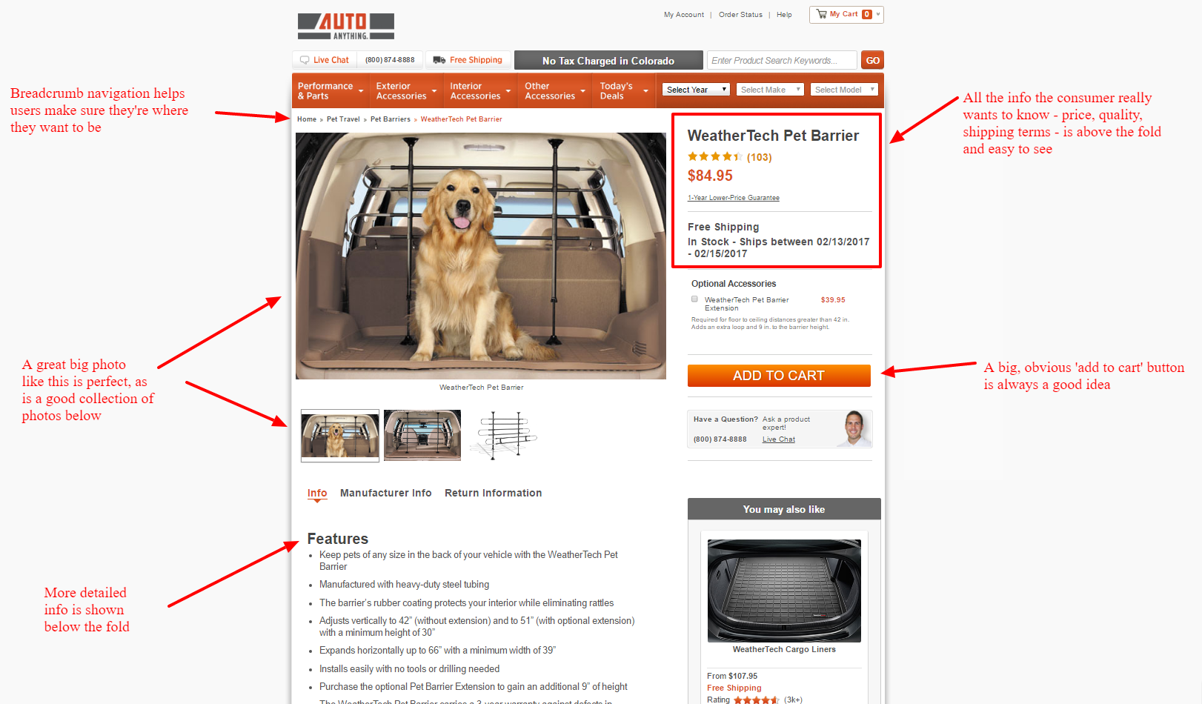
Components

Slide 60
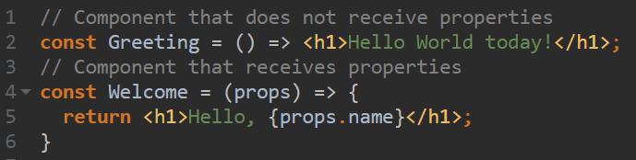
Sample Components

Slide 61
Component Definition
React lets you define components as classes or functions

Slide 62
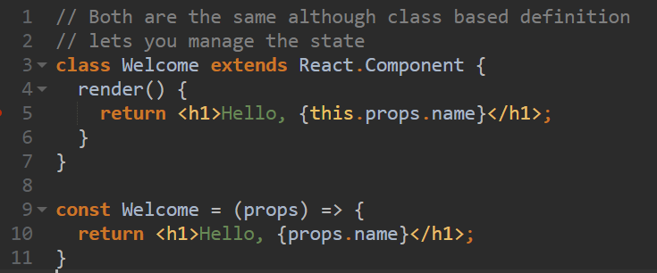
Component Definition

Slide 63
IMPORTANT!!
Always start component names with a capital letter.
React treats components starting with lowercase letters as DOM tags. For example, <div/> represents an HTML div tag, but <Welcome/> represents a component and requires Welcome to be in scope.

Slide 64
Smart Components
Also called container, stateful, etc. components
Mostly concerned with how things work.
Where state is managed.
Where all data processing performed

Slide 65
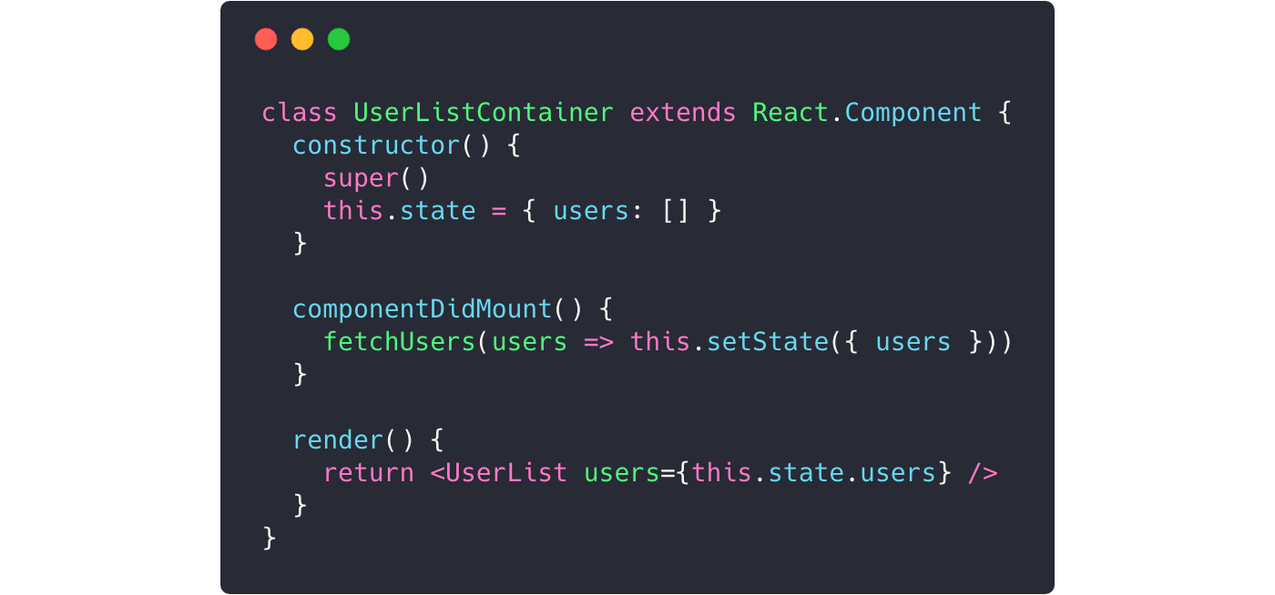
Smart Components

Slide 66
Dumb Components
Also called presentation, stateless, etc. components
Mostly concerned with how things look.
No data processing performed (ideally)
Receives data and presents it to the DOM

Slide 67
Dumb Components
Notes:
!!!Demo

Slide 68
Components Composition
Components can refer to other components in their output. This lets us use the same component abstraction for any level of detail.
A button, a form, a dialog, a screen: in React apps, all those are commonly expressed as components.
Notes:
!!!Demo

Slide 69
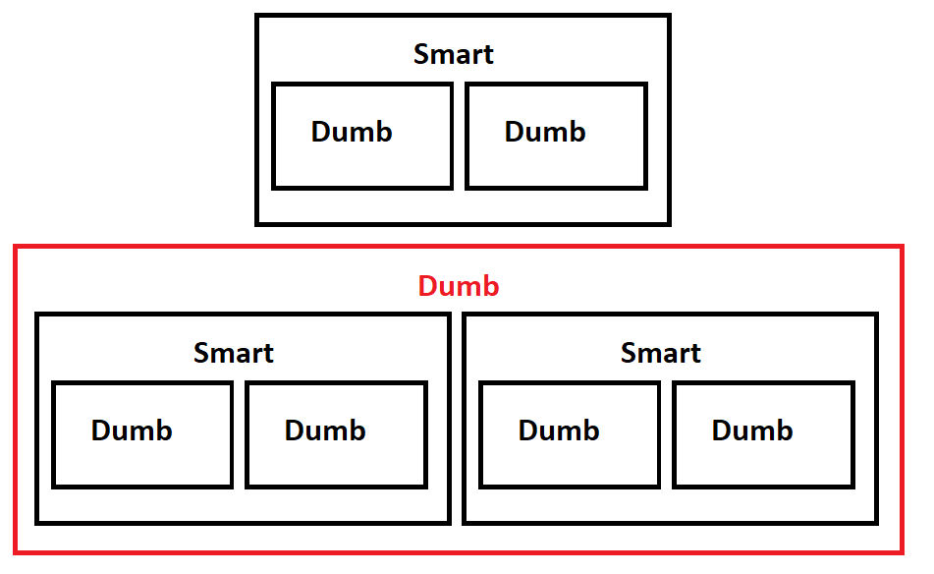

Slide 70
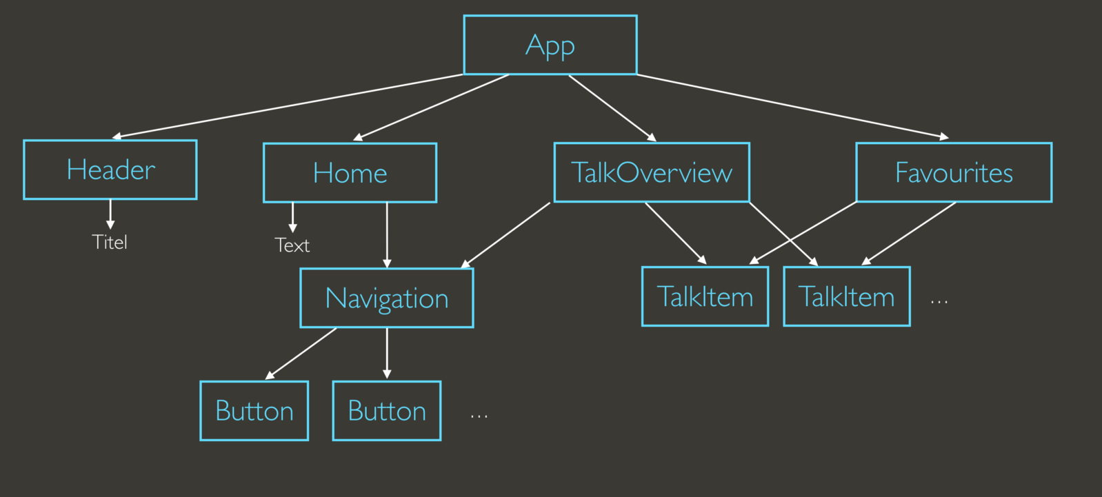

Slide 71
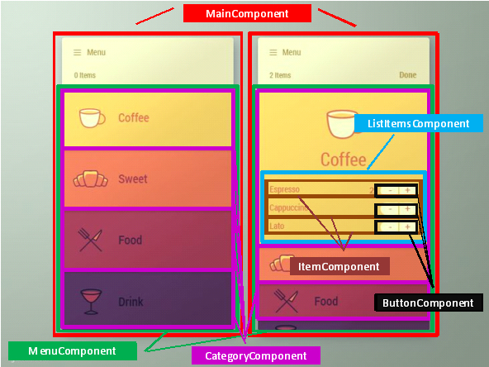

Slide 72
Summary
ReactJS is a micro library for UI rendering
ReactJS uses VirtualDOM to update the DOM that is why it's fast
All ReactJs applications are made up of components

Slide 73
Summary
Components are made up of elements
There are 2 types of components Smart vs Dumb
You can define components via class or by a function
Its up to you how you compose your app

Slide 74
JSX

Slide 75
JSX
JSX (Javascript + XML)
JSX is a preprocessor step that adds XML syntax to JavaScript.
Just like XML, JSX tags have a tag name, attributes, and children. If an attribute value is enclosed in quotes, the value is a string. Otherwise, wrap the value in braces and the value is the enclosed JavaScript expression.
Notes:
To create components we need to use what we call JSX. So what is JSX?

Slide 76
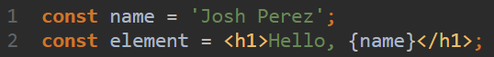
How to embed expression in JSX?
You can put any valid JavaScript expression inside the curly braces in JSX. For example, 2 + 2, user.firstName, or formatName(user) are all valid JavaScript expressions.

Slide 77
JSX is an Expression Too
After compilation, JSX expressions become regular JavaScript function calls and evaluate to JavaScript objects.
This means that you can use JSX inside of if statements and for loops, assign it to variables, accept it as arguments, and return it from functions:

Slide 78
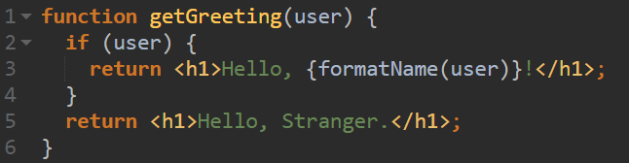

Slide 79
Specifying Attributes with JSX
You may use quotes to specify string literals as attributes:
You may also use curly braces to embed a JavaScript expression in an attribute:

Slide 80
Specifying Attributes with JSX
Don’t put quotes around curly braces when embedding a JavaScript expression in an attribute. You should either use quotes (for string values) or curly braces (for expressions), but not both in the same attribute.

Slide 81
Warning!!
Since JSX is closer to JavaScript than HTML, React DOM uses camelCase property naming convention instead of HTML attribute names.
For example, class becomes className in JSX, and tabindex becomes tabIndex.
Just search the docs for the correct attribute name

Slide 82
Specifying Children with JSX
If a tag is empty, you may close it immediately with />, like XML:

Slide 83
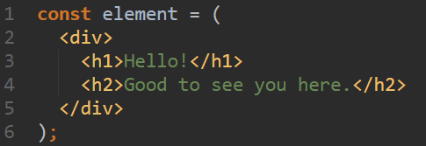
JSX tags may contain children:

Slide 84
Summary
React applications are composed of components
Components are made using JSX
JSX is javascript + html
JSX is closer to javascript than to html

Slide 85
Activity 2
Create a site with dumb and smart components
Minimum of 5 components should be used
No restriction on the page you want to build

